Slide 1
CPT Virtual Information Session
Notes:
Hello, and welcome to the ISSS international student CPT and OPT information session. Not the workshop required for application staff on chat while presentation is going Q&a at end of each section

Slide 2
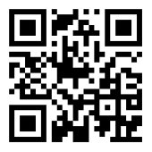
WELCOME PANTHERS! Please to sign in for today’s event!

Slide 3
How do I know if I am eligible?
FOR CPT
You have been enrolled full time for at least two semesters
Your I-20 is active
You have a core class or an elective class that requires an internship
Your eligibility for any practical training depends on you maintaining your F-1 status.
A student must be maintaining valid F-1 status at the time of application and throughout the duration of practical training per immigration law and federal regulations.
Can be a practicum, internship course, co-op, student teaching, or field experience.
Notes:
OPT and CPT must be physically present in the US in order to apply
If not sure about status, can check with our office or in the ISSS portal
hospitality BA does not require a course to complete 1000hours, must still apply with ISSS

Slide 4
CPT
Practical training course work in your major performed for academic credit that applies toward degree audit and graduation. Must be equal to your degree level.
Notes:
Eg- graduate students cannot take an undergrad co-op or internship course to qualify for CPT.

Slide 5
CPT Restrictions
Programs accept a limited amount of credits toward a student's degree audit,
In most cases, a student will be limited to one CPT authorization.
CPT is for academic purposes and practical training- the school's curriculum governs CPT not the student's desire for employment
Authorization of CPT is at the discretion of ISSS Designated School Officials (DSO). CPT will not be authorized in situations where Pre- Completion Optional Practical Training is more appropriate for training to be done prior to completion of degree.

Slide 6
CPT Restrictions Con’t
DHS requires the physical presence of students on-campus at the school owning the student's I-20. Therefore, internships taken Fall and Spring semesters must be local in S. FL . If you wish to have opportunities for CPT outside of S Florida, arrange to take your CPT in summer prior to graduating.
CPT in the final semester – CPT must be local in S. FL and be accompanied by an in-person course that runs the entire semester. This includes summer graduation

Slide 7
Curricular Practical Training (CPT)
Part-time CPT : 20 hours or less per week You must be enrolled for at least 1 credit
Full-time CPT: 21 hours or more per week
You must be enrolled for 3 credits
Once authorization is granted, CPT hours may not be changed.
A student who engages in 12 months of full-time CPT will lose eligibility for optional practical training (OPT)
For CPT that happens in the Fall, Spring, and/or last semester a student must be enrolled in at least one in-person/on-campus class. (You cannot do an internship outside of Miami)
Practical training must always be authorized, either by an ISSS advisor or USCIS.

Slide 8
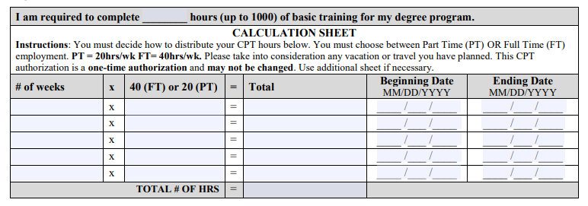
Curricular Practical Training (CPT)
Undergraduate hospitality students Complete the hospitality 1000 hours form with your academic advisor, complete the hours breakdown.
1000 hours of basic training does not affect your OPT, because it is required by your program
Graduate Hospitality students pursuing CPT need to sign up for a class, and apply for traditional CPT

Slide 9
Curricular Practical Training (CPT)
Graduate Students:
If an internship is not required by your program, CPT will be authorized only if you are registered for a graduate level internship or Co-Op course.
Ph.D. students and students enrolled in a master’s with thesis option are INELIGIBLE for CPT if they have completed all coursework and are registered for thesis or dissertation credits only.

Slide 10
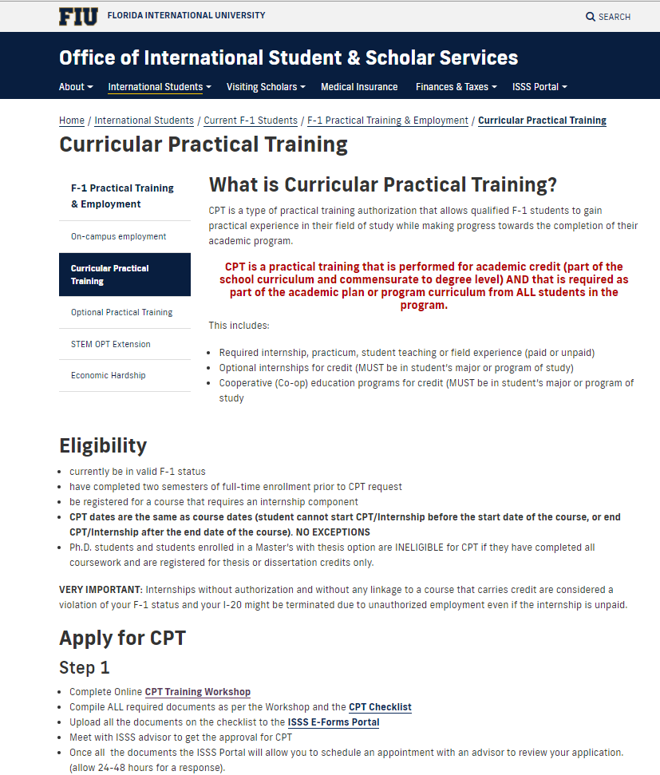
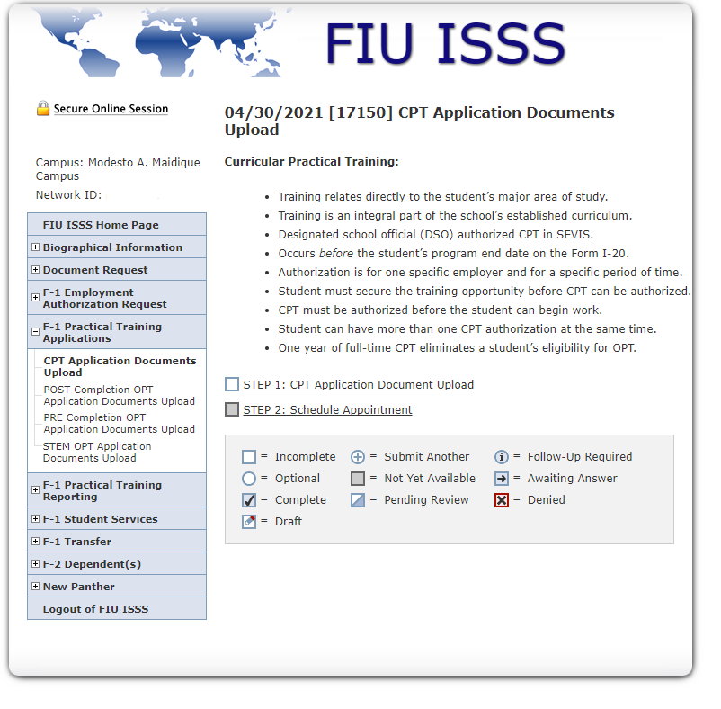
How do I apply?
Visit our website
Apply via the ISSS portal

Slide 11
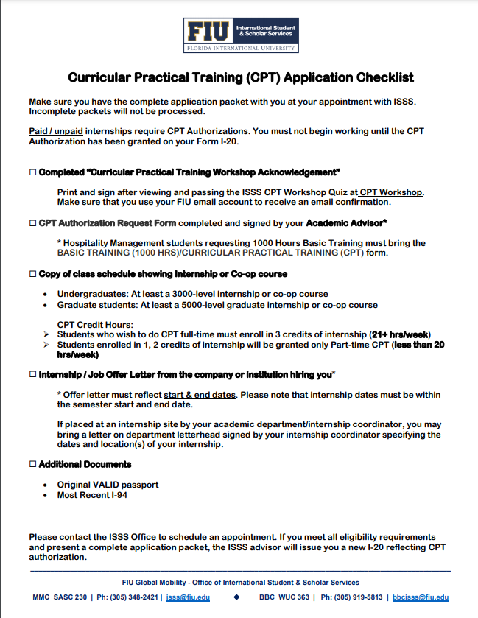
Curricular Practical Training (CPT)
Use the CPT Checklist- you will need:
CPT Authorization request form completed and signed by your academic advisor
Copy of class schedule showing internship or co-op course
Internship offer letter from the company OR a letter on department letterhead signed by your internship coordinator specifying the dates of your internship.
Completed “Practical training workshop acknowledgement”

Slide 12
You must still view
ISSS CPT Online information
isss.fiu.edu
Click on practical training

Slide 13
Sign in reminder Please scan the QR Code to sign in for today’s event!

